Slide 1
IT-331 ( Computer Graphics 1)
Lecture 1
Course Introduction & Plan
Dr. Mohammed El-Said
Assistant Professor, Computer Science Dept.,
Faculty of Computers & Artificial Intelligence,
Helwan University - Cairo, Egypt.

Slide 2
Outline
Course Details
Course Staff: Instructors (Short Bio)
Learning Objectives
Course Materials & Announcements
Assessment Summary (Grading Policy)
Outline
2

Slide 3
Course Details
Course Code IT331
Course Name Computer Graphics 1
Coordinating Unit Computer Science Department,
Faculty of Computers & Artificial Intelligence, Helwan University
Term Semester 2 (Spring)
Level Undergraduate - Levels 3, 4

Slide 4
Course Staff: Instructors (Short Bio)
Dr. Mohammed El-Said
Bachelor in Computer Science from Helwan University
Masters in Computer Science (Image Processing) from Helwan University
PhD. in Computer Science (Computational Linguistics) from Helwan University

Slide 5
What is Computer Graphics?
“Computer graphics is a sub-field of computer science and is concerned with digitally synthesizing and manipulating visual content.”
A broad classification of major subfields in computer graphics might be:
Imaging: studies image acquisition or image editing
Rendering: studies algorithms to reproduce light transport
Geometry (modeling): studies with ways to represent and process surfaces
Animation: studies with ways to represent and manipulate motion

Slide 6
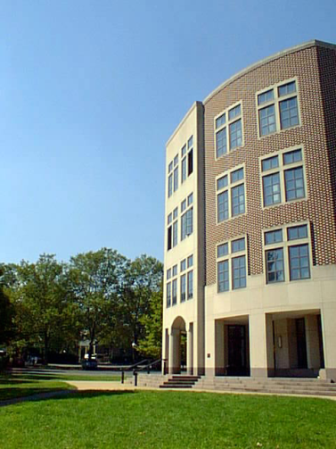
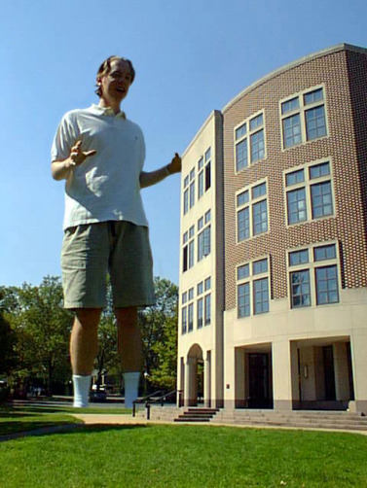
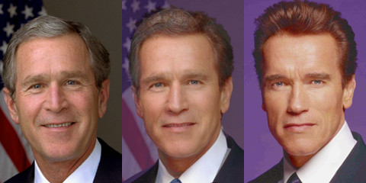
Imaging
Image Representation
Sampling
Reconstruction
Quantization & Aliasing
Image Processing
Filtering
Warping
Morphing
Raster Graphics
Display devices
Color models
Image composition
Image morphing

Slide 7
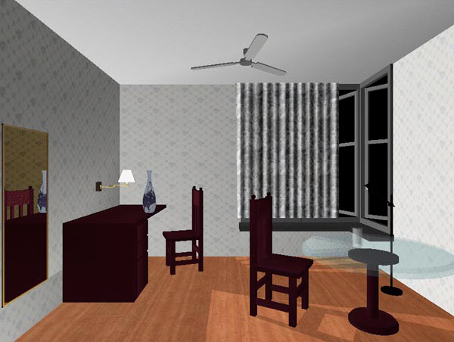
Rendering
3D Rendering Pipeline
Modeling transformations
Viewing transformations
Hidden surface removal
Illumination, shading, and textures
Scan conversion, clipping
Hierarchical scene graphics
OpenGL
Global illumination
Ray tracing
Radiosity
OpenGL example

Slide 8
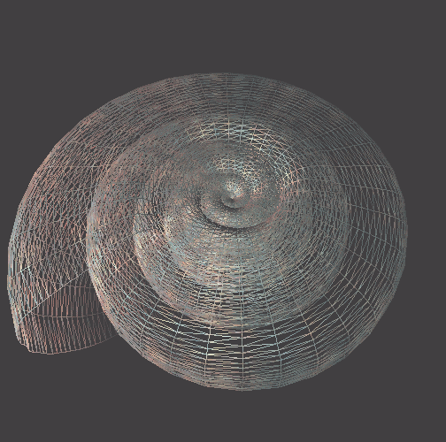
Modeling
Representations of geometry
Curves
Surfaces
Solids
Procedural modeling
Fractals
Shell

Slide 9
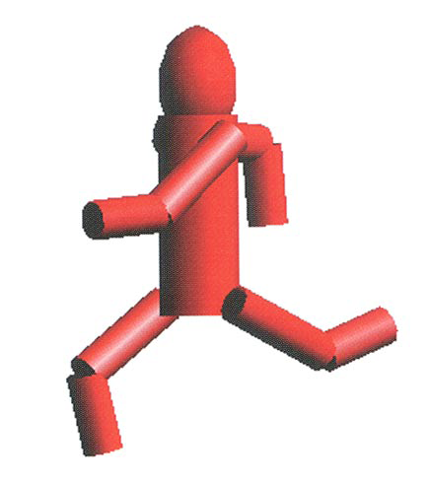
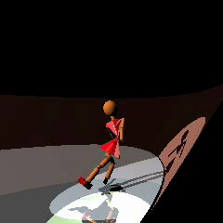
Animation
Keyframing
Kinematics
Articulated figures
Motion capture
Dynamics
Physically-based simulations
Ice Queen

Slide 10
Why computer graphics?
Fun! Visible!
Everywhere
Visual system offers:
Parallel input
Parallel processing
Computer graphics: ideal for human-computer communication

Slide 11
Graphics Applications
Entertainment
Computer-aided design
Scientific visualization
Training
Education
E-commerce
Computer art

Slide 12

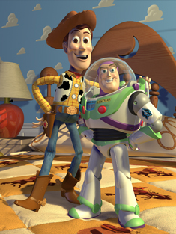
Graphics Applications
Entertainment
Computer-aided design
Scientific visualization
Training
Education
E-commerce
Computer art
Jurasic Park
Toy Story
Quake

Slide 13
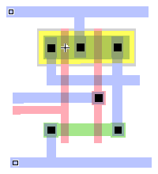
Graphics Applications
Entertainment
Computer-aided design
Scientific visualization
Training
Education
E-commerce
Computer art
Los Angeles Airport
Gear Shaft Design
CMOS Circuit Design

Slide 14
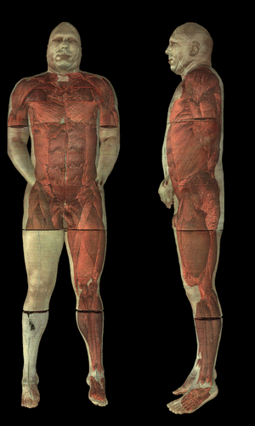
Graphics Applications
Entertainment
Computer-aided design
Scientific visualization
Training
Education
E-commerce
Computer art
Airflow inside a thunderstorm
Visible human

Slide 15
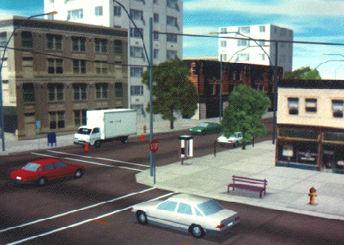
Graphics Applications
Entertainment
Computer-aided design
Scientific visualization
Training
Education
E-commerce
Computer art
Desk Assembly
Driving Simulation
Flight Simulation

Slide 16
Graphics Applications
Entertainment
Computer-aided design
Scientific visualization
Training
Education
E-commerce
Computer art
Human Skeleton

Slide 17
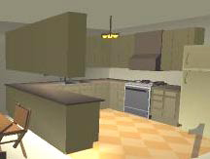
Graphics Applications
Entertainment
Computer-aided design
Scientific visualization
Training
Education
E-commerce
Computer art
Virtual Phone Store
Interactive kitchen planner

Slide 18
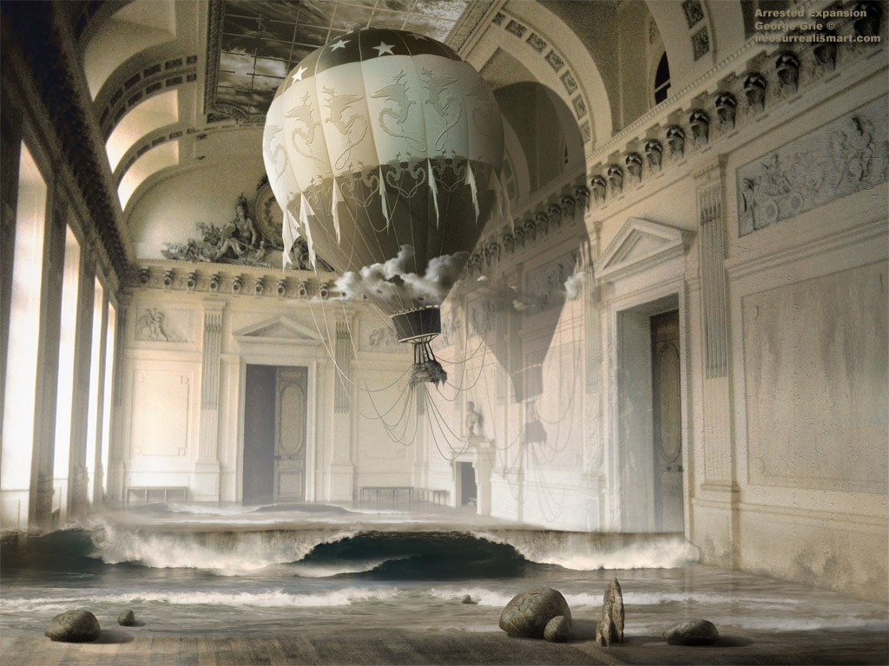
Graphics Applications
Entertainment
Computer-aided design
Scientific visualization
Training
Education
E-commerce
Computer art
Fantasyartdesign.com

Slide 19
Applications
Graphs and charts
Computer-Aided Design
Virtual Reality
Data Visualization
Education and training
Computer Art
Movies
Games
Graphical User Interfaces
H&B 1:2-32

Slide 20
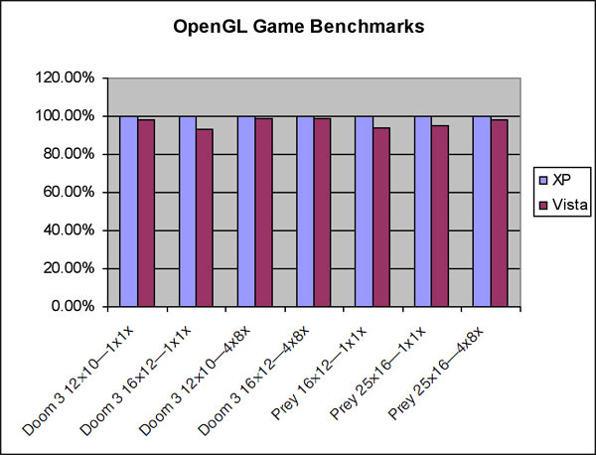
Business graphics
H&B 1:2-32

Slide 21
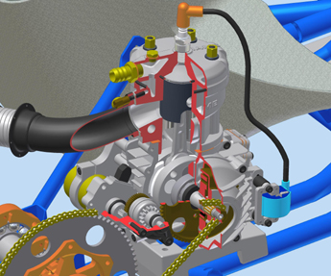
Computer-Aided Design
AutoDesk
IAME 2-stroke race kart engine

Slide 22
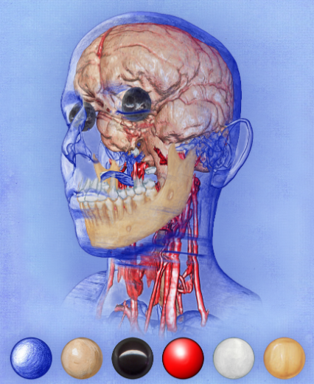
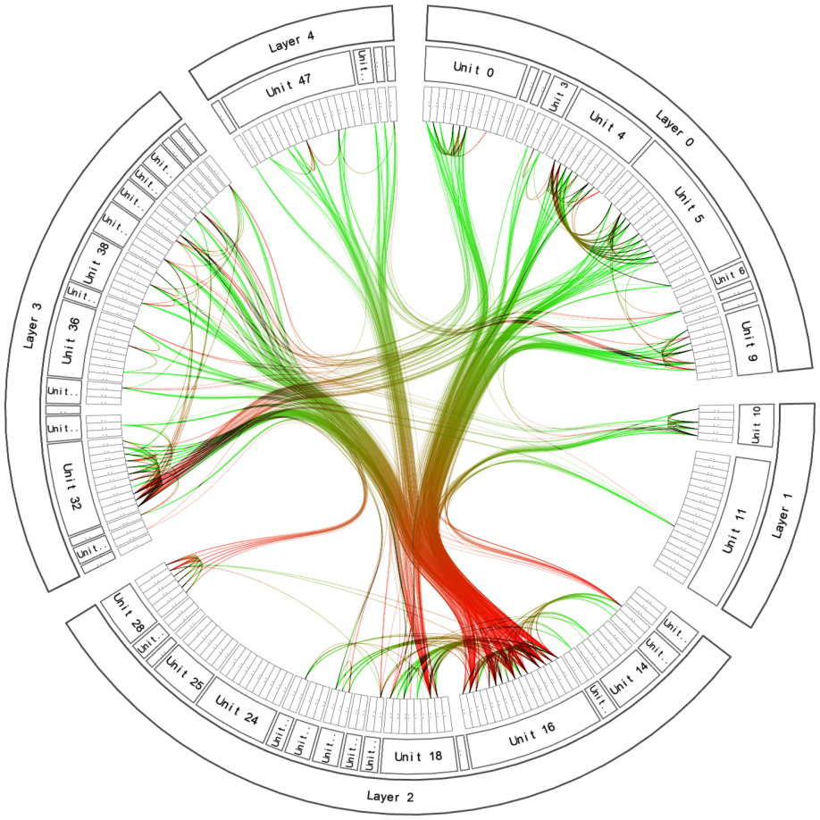
Data Visualization
Bruckner and Groeller,
TU Vienna, 2007
Holten, TU/e, 2007
H&B 1:2-32

Slide 23

Gaming
H&B 1:2-32

Slide 24

Movies
expression
depth of field
fracture
motion
water
hair
H&B 1:2-32
reflection

Slide 25
From model to image
Model
World
View
NDC
Display
Graphics pipeline
Coordinates and transformations
H&B 3-1:60-61

Slide 26
From model to image
Model
World
View
NDC
Display
Cylinder:
Local or modeling coordinates
Geometric modeling
H&B 3-1:60-61

Slide 27
From model to image
Model
World
View
NDC
Display
Position cylinders in scene:
World coordinates
H&B 3-1:60-61

Slide 28
From model to image
Model
World
View
NDC
Display
Look at cylinders,
project on virtual screen
Viewing coordinates
Visible surfaces, shading
H&B 3-1:60-61

Slide 29
From model to image
Model
World
View
NDC
Display
Display:
Normalized Device Coordinates
1
0
1
H&B 3-1:60-61

Slide 30
From model to image
Model
World
View
NDC
Display
Display on screen:
Device Coordinates
0
1024
768
Interaction
H&B 3-1:60-61

Slide 31
Generating graphics
Special-purpose programs
Photoshop, Powerpoint, AutoCAD, StudioMax, Maya, Blender, PovRay, …
General graphics libraries and standards
Windows API, OpenGL, Direct3D,…
H&B 3-2:61-62

Slide 32
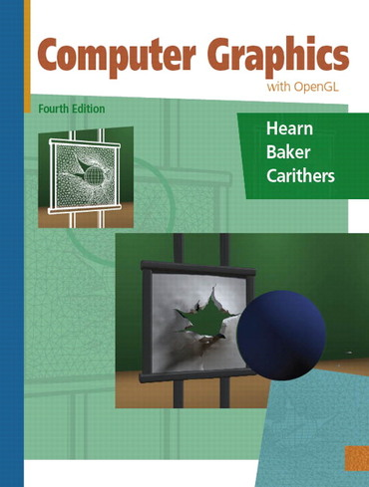
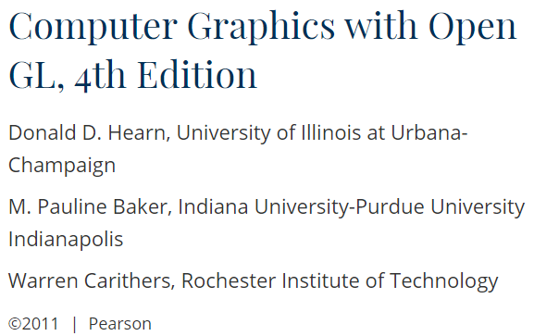
Textbook

Slide 33


Course Materials & Announcements
Course web page:
http://fcai.ml/gfx/2023
MS Teams Code: rcbz6ap

Slide 34
Assessment Summary (Grading Policy)
The Assessment for this subject consists of five components with the following weightings (grading breakdown):
Final Written Exam 50%
Midterm Written Exam 20%
Graphics Package ( Desktop / C# ) 10%
2D Game ( Unity / C# ) 10%
3D Game ( Unity / C# ) 10%

Slide 35
Bonus Points
Any of the following will make you a candidate for getting bonus points
Draw your own 2d drawings (sprites, pictures, or any assets) by yourself
Create your own 3d Models by yourself
Many Platforms: Run your game on two or more platforms (Windows, Android, iOS)
Multi-Player: for example, play in two android devices (must be 2 different devices)
Cross-Platform Multi-Player: for example, play on Android vs iOS
Upload the game to Android Play Store

Slide 36
Thanks! .. Questions?

